Slide 1
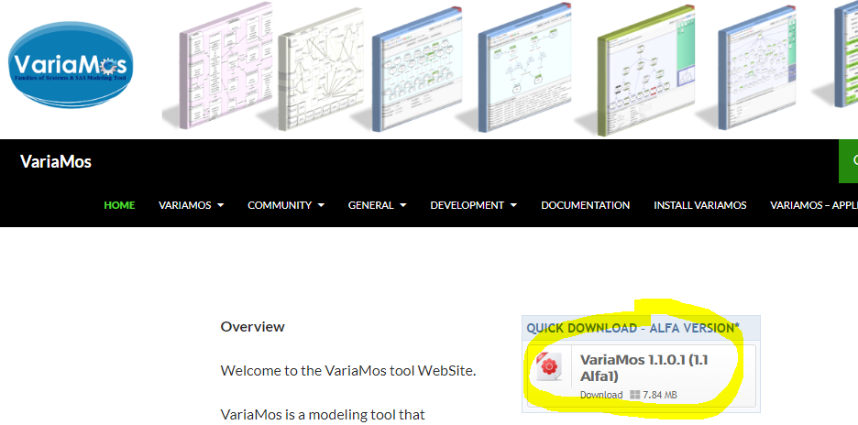
Practical work with FragOP – Its installation
Download VariaMos (alfa version) www.variamos.com

Slide 2
FragOP - I
Fragment-oriented programming (FragOP) is a framework to design and implement software product line domain components, and derive software products.
FragOP is a mix between a compositional and an annotative approach
FragOP is based on:
Domain components - Customization points
Fragmentation points - Customization files
Fragments

Slide 3
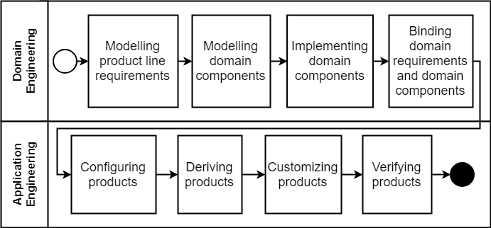
FragOP - II
FragOP was integrated inside VariaMos (Mazo et al., 2015). Supporting the complete FragOP process.

Slide 4
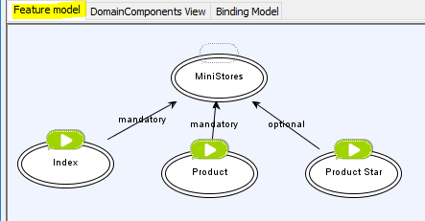
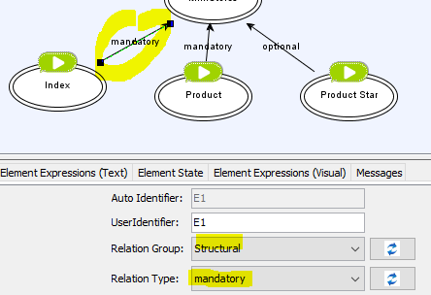
FragOP - III
Open VariaMos, and create the next model
RootFeature
LeafFeature
In order to create the lines, make a click over each leaf feature and hold it to the root feature.

Slide 5
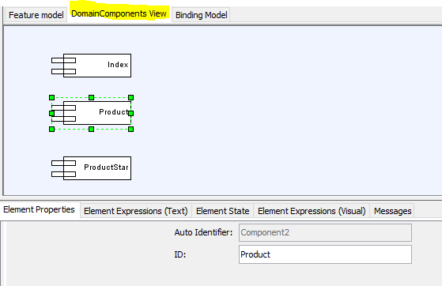
FragOP - IV
Create the component model
Create these 3 components

Slide 6
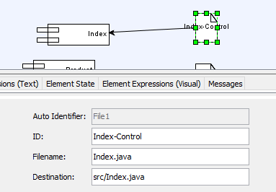
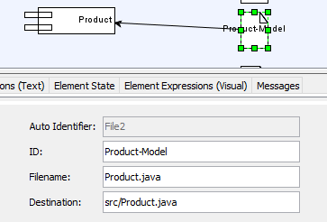
FragOP - V
Create the next files
ID: Index-Control
Filename: Index.java Dest: src/Index.java
ID: Product-Model
Filename: Product.java Dest: src/Product.java

Slide 7
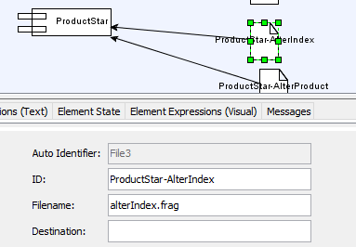
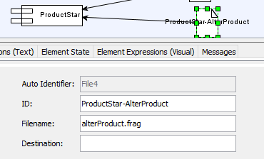
FragOP - VI
Create the next files
ID: ProductStar-AlterIndex Filename: alterIndex.frag
ID: ProductStar-AlterProduct
Filename: alterProduct.frag

Slide 8
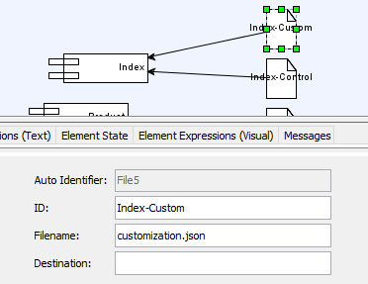
FragOP - VII
Create the next files
ID: Index-Custom Filename: customization.json

Slide 9
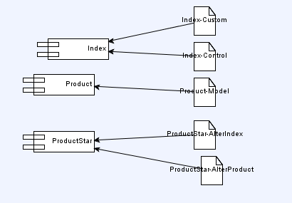
FragOP - VIII
Final model

Slide 10
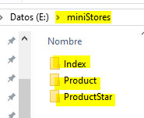
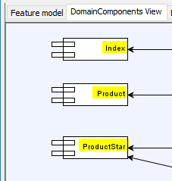
FragOP - IX
Create the component pool folder (anywhere you want) - called “miniStores”.
Create 3 folders with exactly the same name as the component IDs
Component pool
Component folders

Slide 11
FragOP - X
Download and extract these files: https://mega.nz/#!GBJ1mK5T!CQ87F1F-eo3bTaz6HwGp5olvnMzpmU-wKVReRcgJPF4
Put the previous files over their corresponding folders.
Index.java (Domain component) -> Inside Index folder
customization.json (Customization file) -> Inside Index folder
Product.java (Domain component) -> Inside Product folder
alterIndex.frag (Fragment) -> Inside ProductStar folder
alterProduct.frag (Fragment) -> Inside ProductStar folder
We will introduce some new concepts in the next slides.

Slide 12
FragOP - XI
Product.java (Domain component)
public class Product { private int id; private String name; private int price; public int getId() { return id; } …. public Product(int id, String name, int price) { super(); this.id = id; this.name = name; this.price = price; } }

Slide 13
FragOP - XII
Index.java (Domain component)
public class Index { public static void main(String[] args) { System.out.println("Welcome to the store called: XXXXXXX"); System.out.println("Check the new product:"); Product p1=new Product(1,"TV 50",100); System.out.println(p1.getName() + " - price " + p1.getPrice()); } }

Slide 14
FragOP - XIII
Now let’s going to introduce some fragmentation points (variation points)
public class Product { private int id; private String name; private int price; /*B-attributes*/ /*B-methods*/ public int getId() { return id; } …. public Product(int id, String name, int price /*B-params*/) { super(); this.id = id; this.name = name; this.price = price; /*B-params-assign*/ } }
Fragmentation points
They use the pattern:
LanguageCommentBlock<B|E>-<PointID>LanguageCommentBlock
Fragmentation points allow to indicate places in which code could be altered

Slide 15
FragOP - XIV
Index.java (adding fragmentation points)
public class Index { public static void main(String[] args) { System.out.println("Welcome to the store called: XXXXXXX"); System.out.println("Check the new product:"); /*B-productobject*/ Product p1=new Product(1,"TV 50",100); /*E-productobject*/ System.out.println(p1.getName() + " - price " + p1.getPrice()); } }
The end section (E) is optional because it is used to delimitate where a fragmentation point ends, which is only required to replace and hide actions

Slide 16
FragOP - XV
alterIndex.java (fragment)
FragmentID
Fragment ProductStar-AlterIndex { Action: replace Priority: high FragmentationPoints: productobject PointBracketsLan: java Destinations: Index-Control SourceCode: [ALTERCODE-FRAG]Product p1=new Product(1,"TV 50",100,5);[/ALTERCODE-FRAG] }
Priority: high, medium or low. High priority fragments are assembled first.
Domain file to be altered, including its fragmentation pointID
New code to be injected (it replace the previous object definition)

Slide 17
FragOP - XVI
Fragment ProductStar-AlterProduct1 { Action: add Priority: high FragmentationPoints: attributes PointBracketsLan: java Destinations: Product-Model SourceCode: [ALTERCODE-FRAG]private int star;[/ALTERCODE-FRAG] } Fragment ProductStar-AlterProduct2 { Action: add Priority: high FragmentationPoints: methods PointBracketsLan: java Destinations: Product-Model SourceCode: [ALTERCODE-FRAG] public int getStar() { return star; } public void setStar(int star) { this.star = star; }[/ALTERCODE-FRAG] }
alterProduct.java
(fragment)
Fragment ProductStar-AlterProduct3 { Action: add Priority: high FragmentationPoints: params PointBracketsLan: java Destinations: Product-Model SourceCode: [ALTERCODE-FRAG], int star[/ALTERCODE-FRAG] } Fragment ProductStar-AlterProduct4 { Action: add Priority: high FragmentationPoints: params-assign PointBracketsLan: java Destinations: Product-Model SourceCode: [ALTERCODE-FRAG]this.star = star;[/ALTERCODE-FRAG] }

Slide 18
FragOP - XVII
Fragment shape
Fragment <ID> { Action: <add || replace || hide> Priority: <high || medium || low> PointBracketsLan: <language> FragmentationPoints: <pointID1, pointID2, ...> Destinations: <fileID1, fileID2, ... || path1, path2, ...> SourceFile: <filename> SourceCode: [ALTERCODE-FRAG]<code>[/ALTERCODE-FRAG] }

Slide 19
FragOP - XVIII
Index.java (adding customization points)
public class Index { public static void main(String[] args) { /*BCP-store-name*/ System.out.println("Welcome to the store called: XXXXXXX"); /*ECP-store-name*/ /*B-productobject*/ Product p1=new Product(1,"TV 50",100); /*E-productobject*/ System.out.println(p1.getName() + " - price " + p1.getPrice()); } }
Very similar to fragmentation points, they must include a begin section (BCP) and an end section (ECP)

Slide 20
FragOP – XIX
customization.json (Customization file)
{ "CustomizationPoints": ["store-name"], "PointBracketsLans": ["java"], "IDs": ["Index-Control"] }

Slide 21
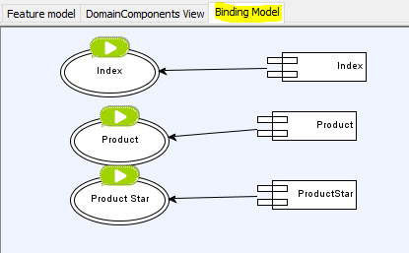
FragOP - XX
Binding between features and components
For now it is only supported a one-to-one relationship

Slide 22
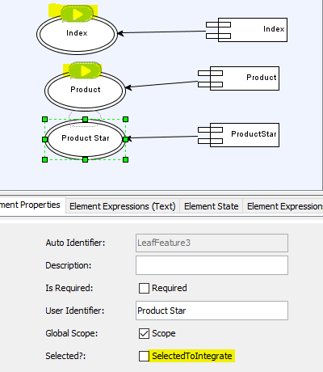
FragOP - XXI
Configuring the products
Select the products to be integrated
Those with a green arrow above them will be integrated

Slide 23
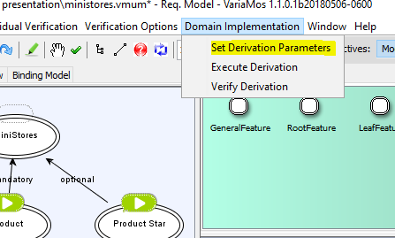
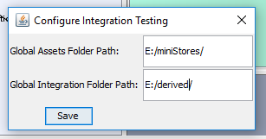
FragOP - XXII
Deriving a product (select all features to be integrated)
Create a folder called derived
“Set derivation parameters”

Slide 24
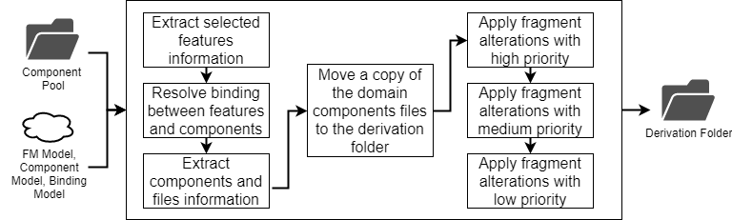
FragOP - XXIII
Deriving a product process

Slide 25
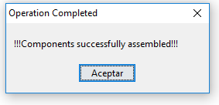
FragOP - XXIV
Click “execute derivation”
Go to the derivation folder and verify that the components were successfully assembled.

Slide 26
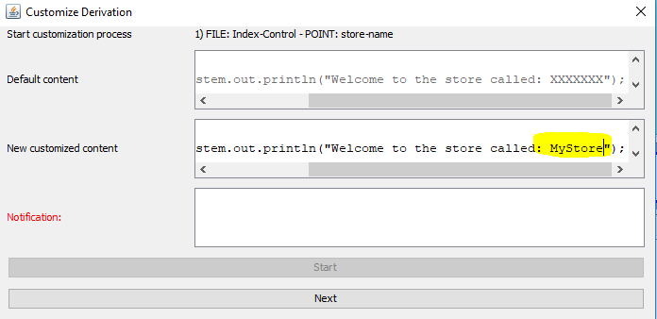
FragOP - XXV
Click “customize derivation”
Click “Start”
Change “XXXXXXX” to “MyStore”
Click “Next”
Go to the derivation folder and verify that the Index.java was successfully customized.

Slide 27
FragOP - XXVI
Click “verify derivation”
Create a new “Java project” over eclipse and move the derived files inside SRC folder.

Slide 28
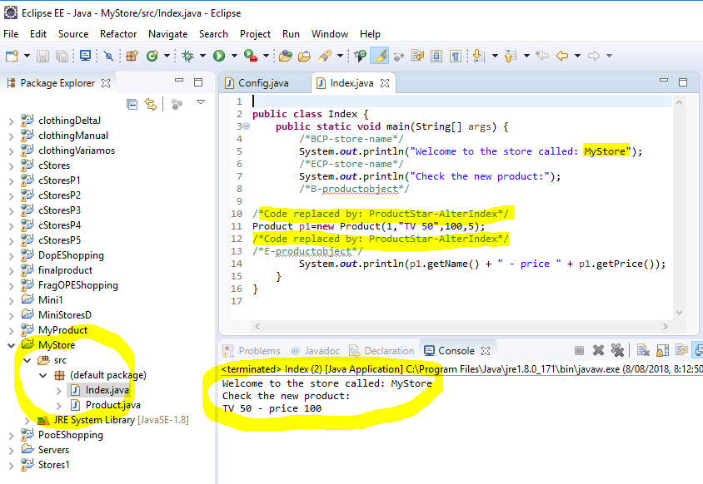
FragOP - XXVII

